Slide 1
Skin Cancer Detection using Convolutional Neural Network and Ensemble Learninig
Soft Computing Project
ITE1015 – B.Tech(IT) Project
Review 1
By:
Aashish Bansal – 19BIT0346
Keerthi Yasasvi – 19BIT0335
Perumalla Sasank – 19BIT0338

Slide 2
Abstract
The project is a CNN trained model which can predict whether the patient has a suffering from Cancer or not by checking the images of the infected areas on the body. The model has been trained on a variety of images through which it predicts the required.
In this project, the image file of the patient is upload into a software, which is GUI-based interface, developed with the help of Tkinter, and it consists of the model saved as a file and the software uses that to analyse the image and give the prediction which can help doctors to start with the medication way faster instead of waiting for the laboratory reports for the confirmation.
So basically,
Skin cancer is an abnormal growth of skin cells. Most skin cancers are caused by exposure to ultraviolet (UV) light. When the skin is not protected, UV rays from sunlight or tanning beds can damage and alter skin's DNA that leads to the cancer.
Deep learning model has been built to classify and identify the binary diagnostic group of melanocytic images obtained through dermoscopy.
Based on the model, disease detection through dermal cell images has been investigated, and classifications on dermal cell images have been performed.

Slide 3
Introduction
The significant growth of medical images and techniques requires comprehensive and exhaustive efforts from a medical professional who is susceptible to human error and the result can also vary widely among various experts.
In this project, we have used the above stated idea behind disease detection, to develop a system using convolutional neural network (CNN) that will help in detection of a particular disease.
The system has been made user-friendly with the help of GUI, so that it can be used not only by the medical professionals but also by the population at large.

Slide 4
About the Disease
Skin cancer is the most prevalent type of cancer. Melanoma, specifically, is responsible for 75% of skin cancer deaths, despite being the least common skin cancer. The American Cancer Society estimates over 100,000 new melanoma cases will be diagnosed in 2020. It's also expected that almost 7,000 people will die from the disease. As with other cancers, early and accurate detection—potentially aided by data science—can make treatment more effective.
Currently, dermatologists evaluate every one of a patient's moles to identify outlier lesions or “ugly ducklings” that are most likely to be melanoma. Existing AI approaches have not adequately considered this clinical frame of reference. Dermatologists could enhance their diagnostic accuracy if detection algorithms take into account “contextual” images within the same patient to determine which images represent a melanoma. If successful, classifiers would be more accurate and could better support dermatological clinic work.
As the leading healthcare organization for informatics in medical imaging, the Society for Imaging Informatics in Medicine (SIIM)'s mission is to advance medical imaging informatics through education, research, and innovation in a multi-disciplinary community. SIIM is joined by the International Skin Imaging Collaboration (ISIC), an international effort to improve melanoma diagnosis. The ISIC Archive contains the largest publicly available collection of quality-controlled dermoscopic images of skin lesions.
In this competition, you’ll identify melanoma in images of skin lesions. In particular, you’ll use images within the same patient and determine which are likely to represent a melanoma. Using patient-level contextual information may help the development of image analysis tools, which could better support clinical dermatologists.
Melanoma is a deadly disease, but if caught early, most melanomas can be cured with minor surgery. Image analysis tools that automate the diagnosis of melanoma will improve dermatologists' diagnostic accuracy. Better detection of melanoma has the opportunity to positively impact millions of people.

Slide 5
Motivation and Objective
Skin cancer is an alarming disease for mankind. The necessity of early diagnosis of the skin cancer have been increased because of the rapid growth rate of Melanoma skin cancer, its high treatment costs, and death rate. This cancer cells are detected manually and it takes time to cure in most of the cases.
The features of the affected skin cells are extracted after the segmentation of the dermoscopic images using feature extraction technique.

Slide 6
Problem Statement
Skin cancer is an ever growing, non-immune disorder in the human society.
Detection of various kinds of skin disorders by training a CNN architecture model with Ensemble Learning and epoch image dataset under supervision to diagnose, identify and suggest treatment stage on identification.

Slide 7
Literature Survey 1-5
Authors &Year | Methodology or Techniques used | Advantages | Issues | Metrics used
May 2020 | CNN, AlexNet, ResNet-18, VGG16, SVM, Black-hat filter, Inpaint Algorithm, Median Filter, Otsu’s Methodology | SVM Accuracy = 86.21%, ResNet Accuracy = 87% | Accuracy Original Data = 80%, Accuracy Augmented Data = 98.61% | ReLU, CNN with Data Augmentation = 88.87%, CNN without Data Augmentation = 78.96%
March 2020 | CNN SENet154, WSL, Adam, weighted loss-entropy | Efficient Architecture | Not much improved with ensemble strategy, Huge Image Size = 600x450 and 1024x1024 | EfficientNet, SENet (T1 = 67.2%, T2 = 70.0%), ResNeXt WSL (T1 = 65.9%, T2 = 68.1%)
2020 | GLCM, HOG, GAC | Feature extraction for early detection | Not enough/adequate dataset | ABCD Rule, SVM Classifier, Accuracy, Sensitivity, Specificity using KNN
2019 | Multiclass SVM, AlexNet, ReLU | Accuracy – 94.016% | Model used is a pre-trained model, robust | GOPS, L1D miss rate
2019 | CNN, pooling layers, dense network, SVM | AlexNet, VGG16, ResNet-18 | Deep Network but Small Dataset – 3000 images | Accuracy = 74%

Slide 8
Literature Survey 6-10
Authors &Year | Methodology or Techniques used | Advantages | Issues | Metrics used
April 2019 | CNN, pooling layer, dense network | Accuracy – 89.5% | Time consuming | Accuracy = 89.5%, Recall = 0.84, Specificity, Precision = 0.8325, F-measure = 0.8325
March 2019 | CNN, Inception V2 Net, K-means Cluster, Max-pooling, Sonification Algorithms | No. of K-means Epochs = 100 | F2-score +ve Prediction = 59.9%, High Sensitivity, Low Specificity | F2-score = 81.8%, Sensitivity = 91.7%, Specificity = 41.8%, Precision = 57.3%
2019 | CNN, McNemar Test, ResNet50, Bonferroni Correction | MATLAB | Small dataset (11,444), training may be inefficient, class imbalance | Accuracy = 100%, detection rate = 100%
2018-2019 | CNN, VGG16, ImageNet | Accuracy – 92.5%, Max-pooling fetches maximum pixel | F1-score = 0.77, VGG16 Accuracy = 78% | Random Forest = 65.9%, XGBoost = 65.15%, SVM = 65.86%, ReLU, Sigmoid
2018 | MatConvNet & GoogLeNet Inception V3 CNN, GoogLeNet, AlexNet, ResNet, VGGNet, Simple Majority Voting, SMP | 1.28 million NATURAL images 500 epochs, pre-trained models used, MatConvNet provides pre-trained CNN models and some functions to create and initialize new neural networks | Limited computational resources, time-consuming procedures | GoggLeNet Error Rate = 0.1, ResNet Error Rate= 0.02, AlexNet Error Rate = approx. 0.001, VGGNet Error Rate = approx. 0.001

Slide 9
Literature Survey 11-15
Authors &Year | Methodology or Techniques used | Advantages | Issues | Metrics used
2020 | CNN | good accuracy | Used standard datasets | Accuracy Image classification
2018 | skin lesions using CNNs | large dataset and large variety | Training should be done on dark-skinned to get accurate classification | Good dataset
2017 | CNN | 129,450 clinical images of dataset and 2,032 different diseases | Separate pre processing required | Large variety
2018 | KNN | 86.67% accuracy in determining the classification. | Small dataset | Accuracy but small dataset
2017 | K-Means | Faster identificaion | Different initial partitions can result in different final clusters. | accuracy of identification of skin cancer from dermoscopic images is directly proportional to the accuracy of the skin lesion segmentation

Slide 10
Literature Survey 16-20
Authors &Year | Methodology or Techniques used | Advantages | Issues | Metrics used
2019 | CNN | 2000 images provided by ISIC (International Skin Imaging Collaboration) | accuracy 74% | CNN; melanoma; skin cancer; image preprocessing
2020 | CNN,ANN, Fuzzy Measures,SVM | 3000 images for training and 600 images for validation | (--) | Accuracy and pression
2017 | SVM, KNN, Decision Tree, Boosted Tree | Trained on different models KNN is 92.70%, SVM is 93.70%, Decision tree (DT) is 89.5% ,boosted tree (BT) is 84.30%. | Improper precision | High accuracy
2017 | KNN, SVM and CNN | Trained on different models | Very small dataset | KNN 85%,SVM 96% CNN 98%
2017 | SVM | spot analysis and guides for the direction of spread of the cancer | Improper pixel results errors | Edge and line detection

Slide 11
Literature Survey 21-25
Authors &Year | Methodology or Techniques used | Advantages | Issues | Metrics used
2019 | STM32, ROC, CNN, ReLu, NLSC | Accuracy - 99%, F1-Score - 99% | computing and index loss, poor lesion skin discrimination specificity | Accuracy
2020 | CNN, Inception-v3, Keras, TensorFlow, DCNN, LeakyReLU, Adamax optimizer, TPR is similar to the positive predictive value | has achieved 90 % accuracy, 91 % precision, 98 %, specificity, and 90 % sensitivity in ISIC-19. | 0.78 AUROC for MEL, 0.86 AUROC for BKL Time consuming | Accuracy
2020 | CNN, keras, Tensorflow, Inception V3, ResNet50, VGG16, MobileNet and InceptionResnet | 7 types of skin lesion diseases identification namely: Benign Keratosis, Dermatofibroma, Vascular Lesion, Melanoma, Melanocytic Nevus, Basal Cell Carcinoma and Actinic Keratosis., InceptionResnet achieved an average accuracy of 91%, Accuracies of 90 and 91% | low F1 score | Accuracy
2017 | GANs, CNN, AlexNet, StyleGANs, InceptionV3-StyleGANs, ResNet50- StyleGANs, VGG16BN- StyleGANs | size of 600×600 as input dataset, trained StyleGANs generate high-quality images in batches, can automatically classify dermoscopy images and enhance the dataset | sets the weight coefficient w in the softmax loss function, decision fusion has certain requirements for selecting CNNs, and selects CNNs with better effects as much as possible, so as to maximize the performance of decision fusion. | Accuracy
2018 | CNN, SciKit, Keras, Tensorflow, OpenCV, ReLU | 90% accuracry, Convolution maintains the spatial interrelation of the pixels, values of the pixels ranging from 0 - 255 i.e 256 pixels. | Rectified Linear Unit is a non-linear operation. ReLU acts on an elementary level , requires large dataset | Accuracy

Slide 12
Literature Survey 26-30
Authors &Year | Methodology or Techniques used | Advantages | Issues | Metrics used
2019 | AlexNet, Ordinary CNN, VGG-16, LIN, Inception-v3, and ResNet, Lévy flight, ReLU | size of input images in the input is considered 28×28 pixel. | doesn’t give the best global solution | Accuracy
2019 | CNN, Feature Extraction, HSV format | Accuracy of 98%. for melanoma skin cancer detection and 93% for melanoma type, TPR of 94.25%, FPR of 3.56%, and EP of 4%, average accuracy of 91.66% | high error rates, 25.6% Caucasian error and 23.2 Xanthous error, validation loss of 57.56% | Accuracy
2019 | CNN, keras, AlexNet, VGG16, SGD optimiser | trained on more than 126k images, higher image augmentation (24x) and image resolution (1k), the same performances can be achieved using less than 5000 images, No impact of image resize filters | Experiments at 277x277 pixel resolution, Experiments without transfer learning | Accuracy
2019 | CNN, grad-CAM, TensorFlow, Inception-ResNet-v2, DenseNet121, Xception | consists of 150,223 clinical images from 543 different skin diseases, achieved an accuracy of 87.25 ± 2.24% on the dermoscopic images for four common skin diseases, including SK, BCC, psoriasis and melanocytic nevus. | Imbalance in sample – creates inefficiency with CNN to differentiate between similar diseases | Accuracy
2020 | MVSM classifier, CNN, feature extraction, GLCM, SVM, ABCD | dataset which consists of eight different classes is compressed into 800 images and applied, The accuracy achieved is about 96.25%. | accuracy is lowered if minute amounts of foreign elements are found on the sample | Accuracy

Slide 13
Summary of Literature Survey
Feature Extraction Methods
Pixel value conversion
Number of channels used in input
Extracting edge feature of an image
Converting the image into matrix

Slide 14
Summary of Literature Survey
The research papers used the following techniques for Model Training and Architecture:
ANN
CNN
KNN
K-means
ResNet
Inception
Xception
Fuzzy Logic
AlexNet
VGG
VGG16
VGG19
SVM
Decision Tree
Boosted Tree
StyleGANs
MatConvNet
GoogLeNet Inception V3
GoogLeNet Inception V1
Simple Majority Voting
SMP

Slide 15
Summary of Literature Survey
The research papers used the following techniques for Model Evaluation:
Accuracy
F-score
Precision
Sensitivity
Specificity
Line Detection
Detection Rate
XGBoost
EfficientNet
SENet (T1, T2)
ResNeXt WSL (T1, T2)
ABCD Rule
SVM Classifier
GOPS
L1D miss rate
GoggLeNet Error Rate
ResNet Error Rate
AlexNet Error Rate
VGGNet Error Rate

Slide 16
Issues in Existing Systems
low accuracy – 16, 18, 22, 23, 29, 30
time consuming – 13, 22, 23, 28, 29
Variants and inadequate Dataset – 14, 19, 11
Improper detection – 12, 15, 20, 21, 27, 30

Slide 17
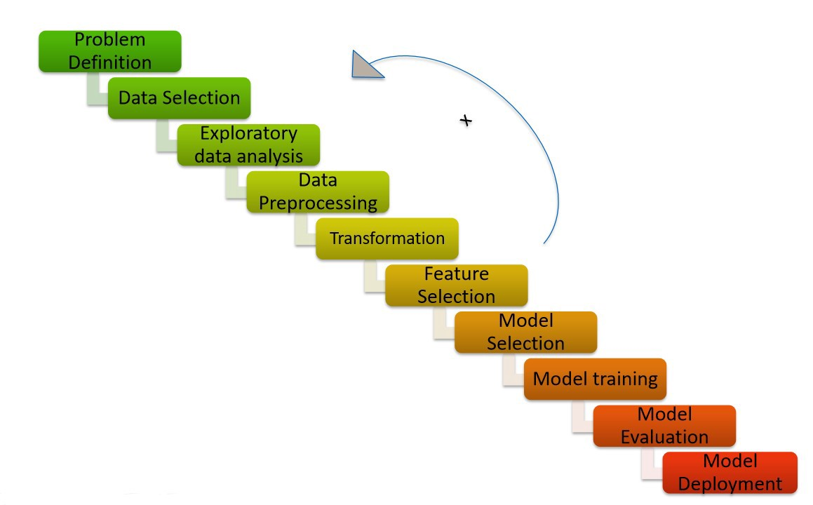
General Architecture
Reference: Machine Learning Development Life Cycle
Link: https://medium.com/analytics-vidhya/machine-learning-development-life-cycle-dfe88c44222e

Slide 18
Proposed title of project
Skin Cancer Detection
Using
CNN and Ensemble Learning

Slide 19
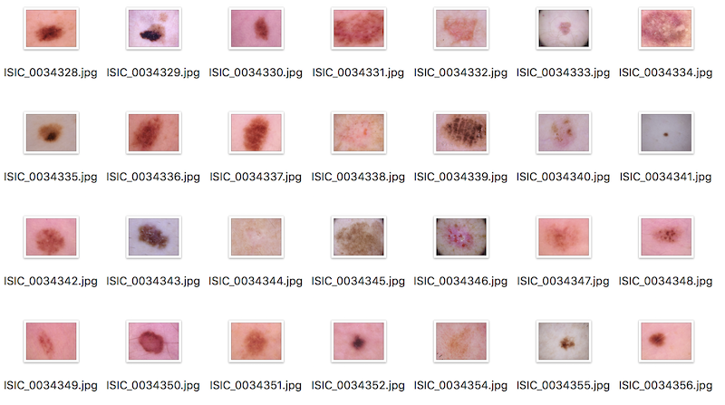
Dataset
Dataset Link:
https://academictorrents.com/details/152479c5e0b31c05c8fafbc23fcd5a20bf7f910b
Dataset Name: ISIC 2017 Melanoma
Source: Kaggle
Reference: ISIC2017: Skin Lesion Analysis Towards Melanoma Detection

Slide 20
Abstract of Dataset
The goal of the project is to help us develop image analysis tools to enable the automated diagnosis of melanoma from dermoscopic images. Image analysis of skin lesions is composed of 3 parts:
Part 1: Lesion Segmentation
Part 2: Detection and Localization of Visual Dermoscopic Features/Patterns
Part 3: Disease Classification

Slide 21
Image Acquisition
In Image Processing, it is defined as the action of retrieving an image from some source, usually a hardware-based source for processing. It is the first step in the workflow sequence because, without an image, no processing is possible. The image that is acquired is completely unprocessed.
For this project, the original dataset has been obtained from the Kaggle and the dataset has been uploaded into the Google Drive as a zip file. With the help of a Python Library, the Google Drive can be authorised using which we can access the dataset by just importing the dataset into the model and then unzipping it.

Slide 22
Image Pre-processing
Image processing is divided into analogue image processing and digital image processing. Digital image processing is the use of computer algorithms to perform image processing on digital images. As a subfield of digital signal processing, digital image processing has many advantages over analogue image processing. It allows a much wider range of algorithms to be applied to the input data — the aim of digital image processing is to improve the image data (features) by suppressing unwanted distortions and/or enhancement of some important image features so that our AI-Computer Vision models can benefit from this improved data to work on. An image is nothing more than a two-dimensional array of numbers (or pixels) ranging between 0 and 255. It is defined by the mathematical function f(x,y) where x and y are the two co-ordinates horizontally and vertically. The value of f(x,y) at any point is giving the pixel value at that point of an image. The dataset is then divided into the train set and test set of 80% and 20% images respectively.

Slide 23
Feature Extraction
Feature extraction is a process of dimensionality reduction by which an initial set of raw data is reduced to more manageable groups for processing. A characteristic of these large data sets is a large number of variables that require a lot of computing resources to process. Feature extraction is the name for methods that select and /or combine variables into features, effectively reducing the amount of data that must be processed, while still accurately and completely describing the original data set.
The process of feature extraction is useful when you need to reduce the number of resources needed for processing without losing important or relevant information. Feature extraction can also reduce the amount of redundant data for a given analysis. Also, the reduction of the data and the machine’s efforts in building variable combinations (features) facilitate the speed of learning and generalization steps in the machine learning process. The dataset comprising of RGB images of skin samples has been taken. The images are 1024x1024 which are resized to 224x224 pixels.

Slide 24
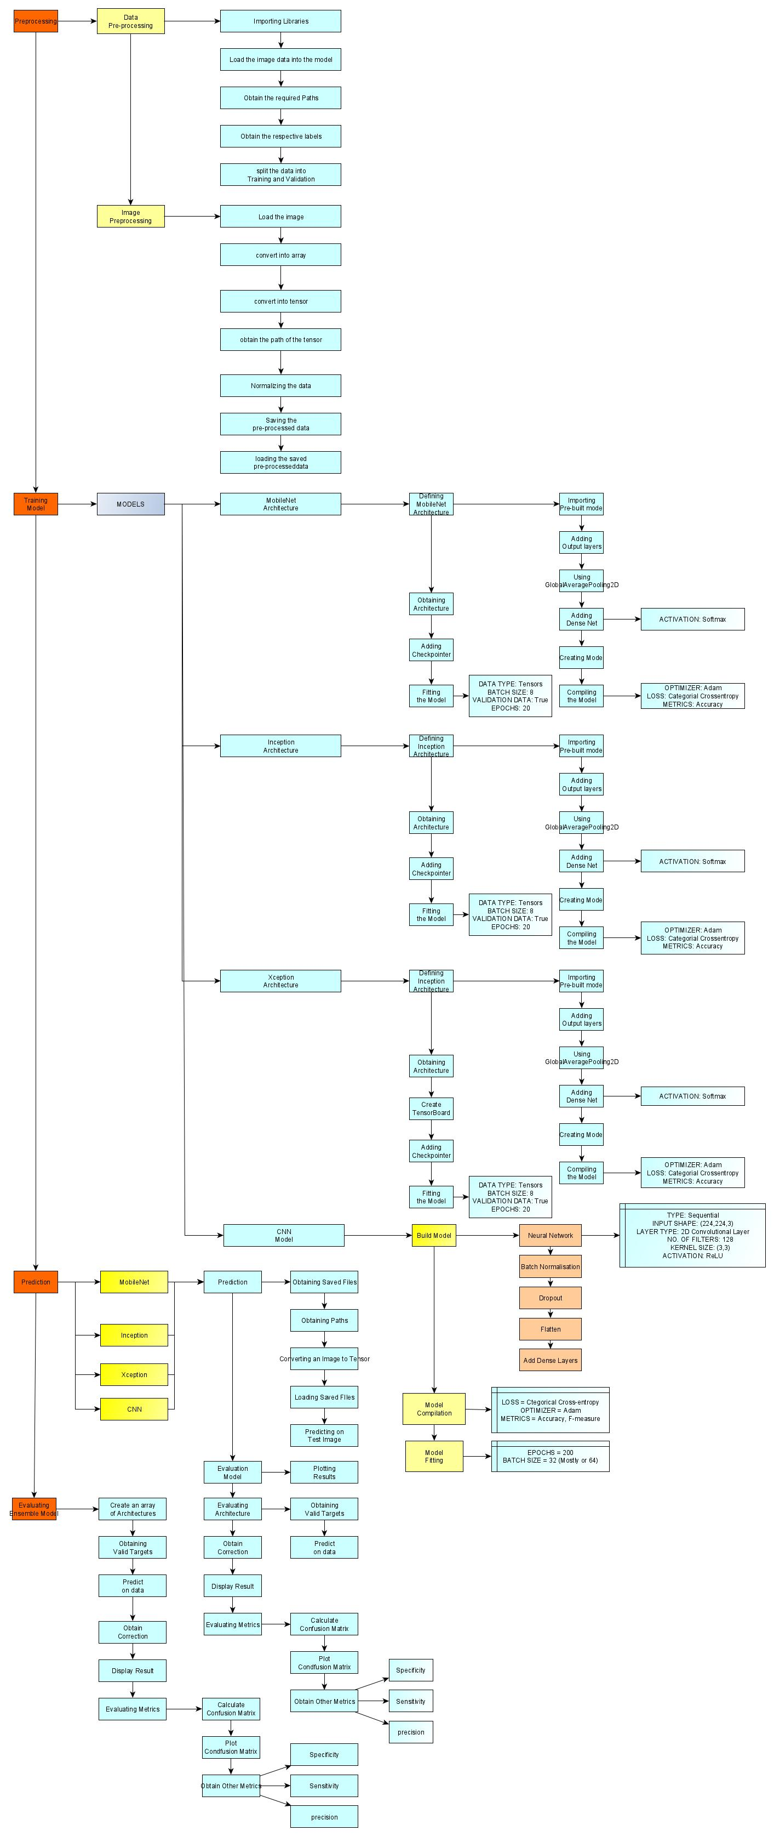
Architecture and Process Flow for the proposed system

Slide 25
Modules and its Description
Neural Network Architectures: MobileNet, InceptionV1, Xception and CNN
Activation Functions: SoftMax, ReLU
Types of Layers: Dense
Normalization: Batch Normalization
Batch Size: 8, 32
Loss Type: Categorical Cross-entropy
Optimizer: Adam
Metrics: Accuracy, Specificity, Sensitivity, precision & probability (F-scores (or) Confusion matrix percentage)

Slide 26
Pre-trained Neural Network: MobileNet

Slide 27
Evaluation Metrics
Classification Accuracy: Classification Accuracy is what we usually mean, when we use the term accuracy. It is the ratio of number of correct predictions to the total number of input samples.
Confusion Matrix: Confusion Matrix as the name suggests gives us a matrix as output and describes the complete performance of the model.
Area under Curve: Area Under Curve(AUC) is one of the most widely used metrics for evaluation. It is used for binary classification problem. AUC of a classifier is equal to the probability that the classifier will rank a randomly chosen positive example higher than a randomly chosen negative example.
F1-score: F1 Score is the Harmonic Mean between precision and recall. The range for F1 Score is [0, 1]. It tells you how precise your classifier is (how many instances it classifies correctly), as well as how robust it is (it does not miss a significant number of instances).

Slide 28
Conclusion
A “health discernment system” has been proposed for medical image classification that will work in real-life scenarios.
The proposed method is based on Ensemble Models and Convolutional Neural Network architecture.
Different sub-models pertaining to the two diseases (skin cancer: Melanoma, Benign) have been designed using convolutional neural network (CNN) and they have all been tested separately.

Slide 29
References
ResearchGate.com
ScienceDirect.com
GeeksforGeeks.com
TutorialsPoint.com
cs.stanford.edu
ncbi.nlm.nih.gov
TowardsDataScience.com
Springer.com
towardsdatascience.com

Slide 30
THANK YOU

